Slide 1
Chapter 8
How to use media queries for Responsive Web Design

Slide 2
Objectives
Applied
Given an HTML document for the desktop that uses a fixed layout, convert it so it uses fluid widths, scalable images, and fonts that are inherited by child elements.
Given an HTML document for the desktop that uses a fluid layout, add media queries that change the appearance of the page depending on the size of the screen where it’s displayed.
Given an HTML document with a navigation menu that uses media queries, use the SlickNav plugin to replace the navigation menu on smaller screen sizes.
Use Chrome’s Developer Tools to test a Responsive Web Design.
Knowledge
Describe the three components of a Responsive Web Design.

Slide 3
Objectives (continued)
Describe the use of Developer Tools for testing a responsive design.
Explain how fluid layouts compare to fixed layouts.
Explain why you should use relative font sizes with a responsive design.
Describe how to create a scalable image.
Describe the use of the meta element for setting the viewport on mobile devices.
Describe the basic syntax of a media query.
Describe the way to determine the breakpoints for media queries.
Explain why you would use the SlickNav plugin when developing a responsive design.
Distinguish between desktop-first and mobile-first code of a responsive design.

Slide 4
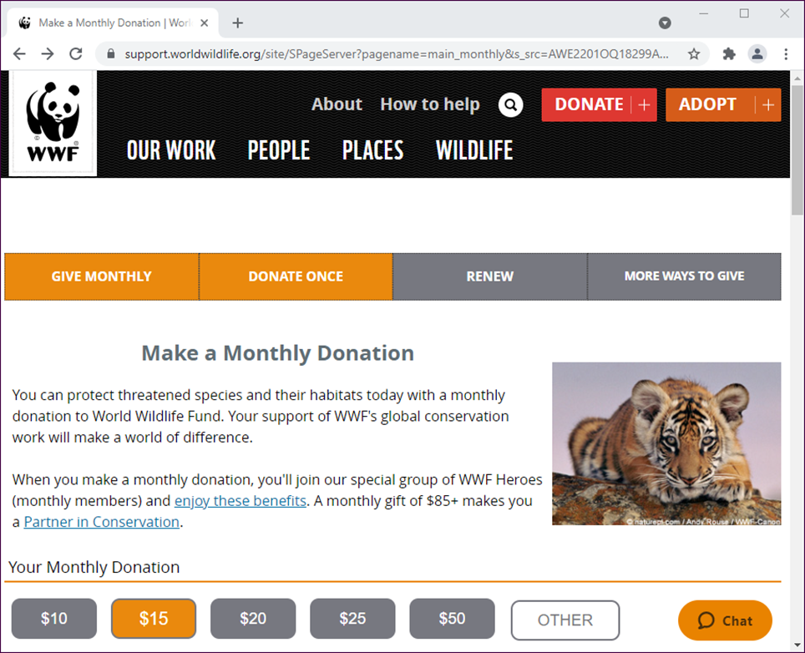
A website that uses RWD: Desktop

Slide 5
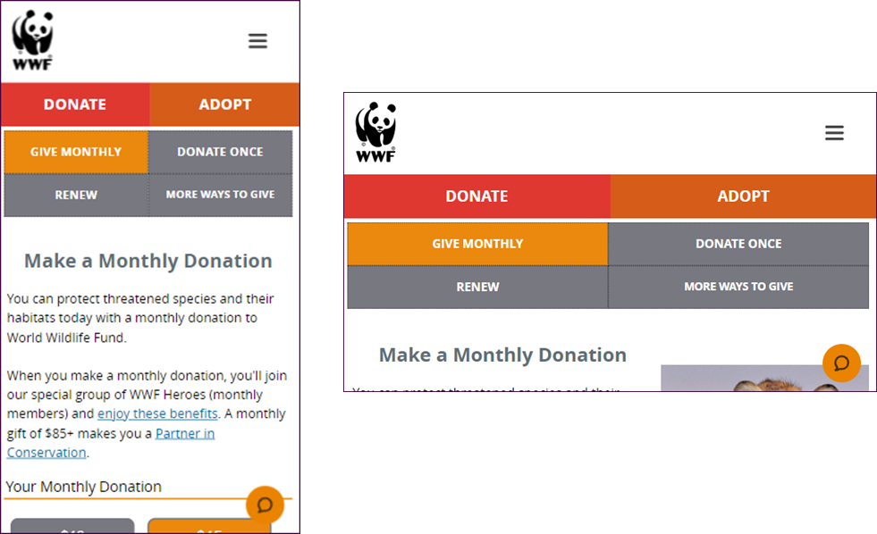
A website that uses RWD: Mobile

Slide 6
The three components of Responsive Web Design
Fluid layout
Scalable images
Media queries

Slide 7
Two ways to test a responsive design
Use the Developer Tools provided by most browsers.
Deploy your website to a server and then test it on each device.

Slide 8
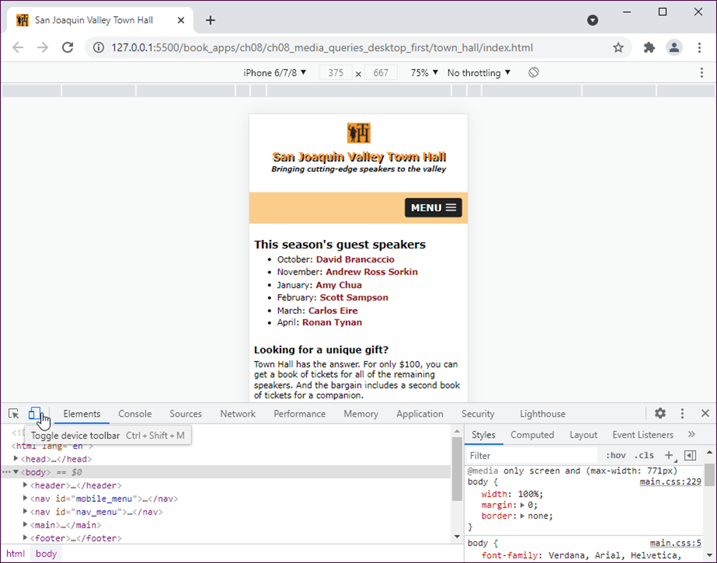
A web page with Chrome’s Developer Tools

Slide 9
How to use Chrome’s Developer Tools to test a responsive design
Display the page in a browser and press F12.
Click the Toggle Device Toolbar icon near the left side of the toolbar. Then, select the device you want to emulate from the drop-down list at the top and middle of the page.
If you select Responsive from the drop-down list, you can also drag the edges of the screen to create a custom size or enter a size in the available boxes.
When a page is displayed for a device, you can use the mouse to work with it just as if the device were there.

Slide 10
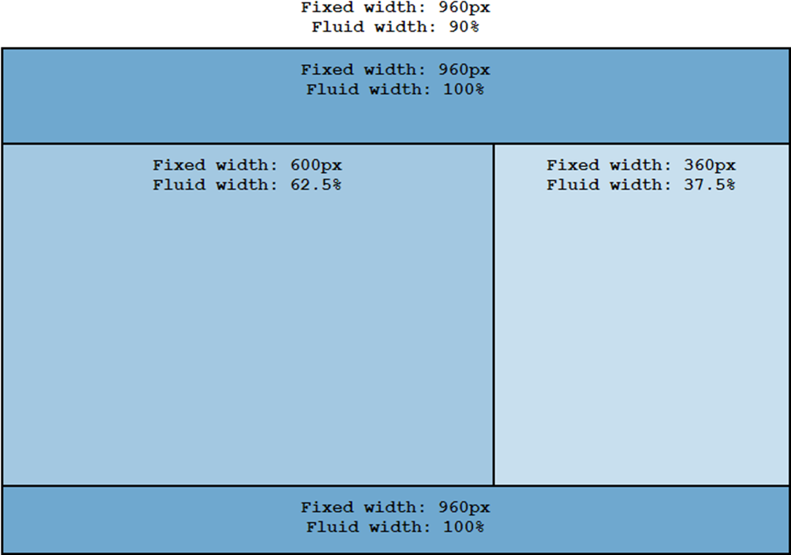
Fixed and fluid widths in a two-column layout

Slide 11
The benefit of fluid layouts
The page layout automatically adjusts to the size of the screen on the device that’s accessing the web page.

Slide 12
A formula for converting pixels to percents
target ÷ context x 100 = result
The HTML for a page with padding and borders
<body>
<header><p>This is the text for the header.</p>
</header>
<main><p>This is the text for the main element.</p>
</main>
<aside><p>This is the text for the aside.</p>
</aside>
<footer><p>This is the text for the footer.</p>
</footer>
</body>

Slide 13
The CSS for a fluid layout
body {
width: 90%; /* changed from 960px */
max-width: 1024px; /* maximum width of page */
margin: 0 auto;
border: 2px solid black; }
header {
width: 96.875%; /* 930 ÷ 960 x 100 */
padding: 15px 1.5625%; /* 15 ÷ 960 x 100 */
border-bottom: 2px solid black; }
main {
width: 59.375%; /* 570 ÷ 960 x 100 */
padding: 15px 1.5625%; /* 15 ÷ 960 x 100 */
float: left; }
aside {
width: 34.375%; /* 330 ÷ 960 x 100 */
padding: 15px 1.5625%; /* 15 ÷ 960 x 100 */
float: right; }
footer {
clear: both;
width: 96.875%; /* 930 ÷ 960 x 100 */
padding: 15px 1.5625%; /* 15 ÷ 960 x 100 */
border-top: 2px solid black; }

Slide 14
Relative units of measure for responsive design
vh
vw
vmin
wmax

Slide 15
The HTML for a simple page
<body>
<header>
<h1>San Joaquin Valley Town Hall</h1>
</header>
<main>
<p>Welcome to San Joaquin Valley Town Hall.
We have some fascinating
speakers for you this season!</p>
</main>
</body>
CSS that sets the width of the body based on the width of the viewport
body {
width: 95vw;
margin: 0 auto; }

Slide 16
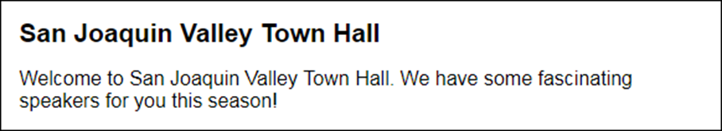
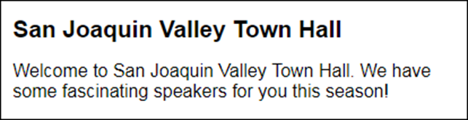
The page when the viewport is 580 pixels wide
The page when the viewport is 412 pixels wide

Slide 17

CSS that sets the width based on the minimum dimension of the viewport
body {
width: 95vmin;
margin: 0 auto; }
The page when the viewport is 580 pixels wide and 180 pixels tall

Slide 18
The HTML for a page with different font sizes
<body>
<header><h2>San Joaquin Valley Town Hall</h2>
</header>
<main>
<h1>This season's guest speakers</h1>
<ul>
<li>...</li>
<li>...</li>
<li>...</li>
</ul>
<p>Please contact us for tickets.</p>
</main>
<aside>
<h3>Lecture day, time, and location</h3>
<p>...</p>
</aside>
<footer>
<p>&copy; Copyright 2022 San Joaquin Valley Town
Hall.</p>
</footer>
</body>

Slide 19
CSS that specifies the font sizes in ems
body {
font-size: 100%;
width: 90%;
max-width: 1024px;
margin: 0 auto;
border: 2px solid black; }
h1 { font-size: 1.75em; }
h2 { font-size: 1.5em; }
h3 { font-size: 1.125em; }
footer p { font-size: .75em; }

Slide 20
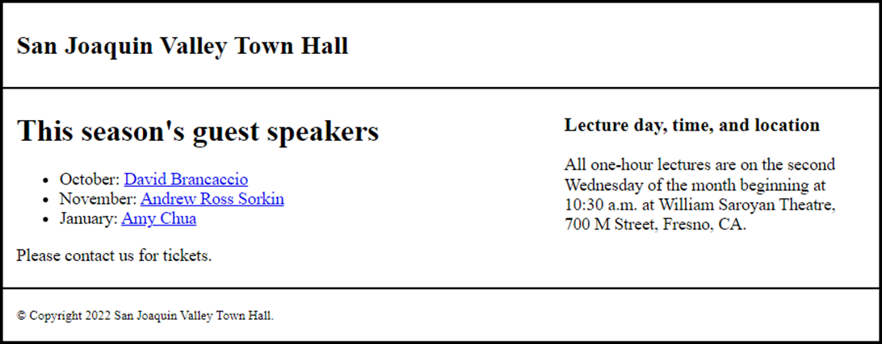
The headings in a browser with some borders

Slide 21

A scalable image in a fluid layout

Slide 22
The HTML for the image
<img src="images/students.jpg"
alt="Instructor with students">
The CSS for the image
section img {
max-width: 100%;
margin-bottom: .5em;
}
CSS that limits the width of the image
section img {
width: 100%;
max-width: 400px;
margin-bottom: .5em;
}

Slide 23
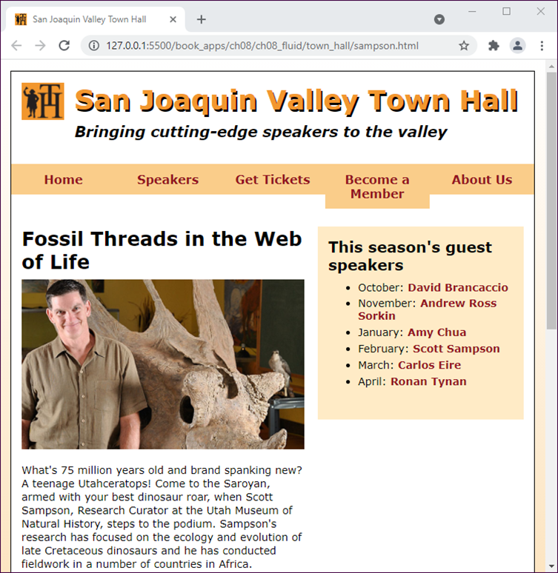
A page with a fluid layout

Slide 24
The CSS for the fluid design (part 1)
/* the styles for the type selectors */
body { font-family: Verdana, Arial, Helvetica,
sans-serif;
font-size: 100%;
width: 96%;
max-width: 1200px; /* maximum width of page */
... }
article, aside, h1, h2, h3, p {
margin: 0;
padding: 0; }
article, aside { margin-bottom: 1em; }
p { font-size: .875em; ... }

Slide 25
The CSS for the fluid design (part 2)
/* the styles for the header */
header { width: 100%; ... } /* full width of body */
header h2 { font-size: 2.25em;
margin-left: 12.12121%; /* 120 ÷ 990 x 100 */
... }
header h3 { font-size: 1.25em;
font-style: italic;
margin-left: 12.12121%; }
header img { width: 8.0808%;
max-width: 80px; /* native size */
min-width: 40px; /* minimum size */
float: left;
margin-left: 2.0202%; }

Slide 26
The CSS for the fluid design (part 3)
/* the styles for the navigation menu */
#nav_menu ul { width: 100%; ... } /* width of body */
#nav_menu ul li { width: 20%; ... }
#nav_menu ul li:hover ul { width: 100%; }
#nav_menu ul li:hover ul li:hover ul li { width: 100%; }
/* the styles for the article */
article { width: 54.0404%;
float: left;
margin-left: 2.0202%;
padding: 1.5em 2.52525% 0 0; }
article h1 { font-size: 1.625em; ... }
article img { max-width: 100%; ... }

Slide 27
The CSS for the fluid design (part 4)
/* the styles for the sidebar */
aside { width: 35.35353%;
float: left;
padding: 2.0202%;
background-color: #ffebc6;
margin: 1.5em 2.0202% 0 0; }
aside h2 { font-size: 1.25em; ... }
aside li { font-size: .875em; ... }
/* the styles for the footer */
footer { width: 100%; ... } /* width of body */
footer p { font-size: .75em;
text-align: right;
margin-right: 2.0202%; }

Slide 28
A web page on a mobile device without and with a meta viewport element

Slide 29
Content properties for viewport metadata
width
height
initial-scale
minimum-scale
maximum-scale
user-scalable
A meta element that sets viewport properties
<meta name="viewport"
content="width=device-width, initial-scale=1">

Slide 30
Common properties for the screen media type
width
min-width
max-width
height
min-height
max-height
orientation

Slide 31
Typical media queries
Checks that the viewport width is 796 pixels or less
@media only screen and (max-width: 796px) {...}
Checks that the viewport width is between 481 and 796 pixels
@media only screen and (min-width: 481px)
and (max-width: 796px) {...}

Slide 32
How to use the range syntax in a media query
A media query for a viewport width of 796 pixels or less
@media only screen and (width <= 796px) { ... }
A media query for a viewport width between 481 and 796 pixels
@media only screen and (481px <= width <= 796px) { ... }

Slide 33
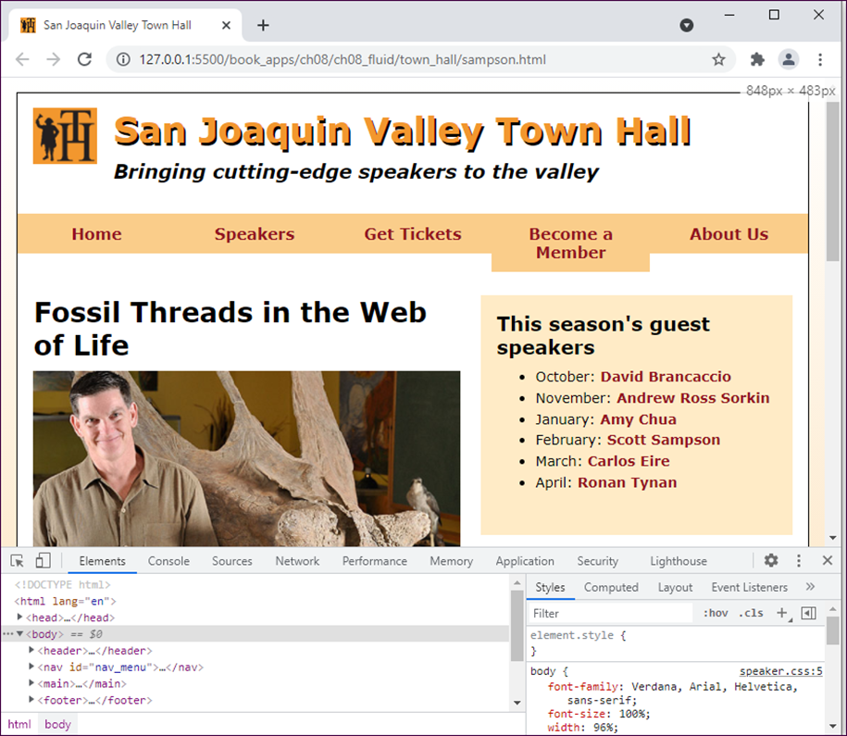
A web page in Chrome as the headings roll over

Slide 34
How to determine the breakpoints
Open the web page in your browser and press F12 to open the Developer Tools.
To determine a breakpoint, drag the right edge of the browser window to the left, and watch for a design break. Then, record the width that’s shown in the upper right corner of the window.
Continue to narrow the window as you record other breakpoints.
When the Developer Tools are docked at the bottom of the browser window in Chrome, the window can only be reduced to 500 pixels.
To display the page at narrower widths, you can dock the Developer Tools at the right or left of the window. Then, you can narrow the window as much as you want.

Slide 35

A multi-tier menu that uses SlickNav
Code for the SlickNav plugin in the head element
<link rel="stylesheet" href="styles/slicknav.css">
<script src="https://code.jquery.com/jquery-3.6.0.min.js">
</script>
<script src="js/jquery.slicknav.min.js"></script>
<script type="text/javascript">
$(document).ready(function(){
$('#nav_menu').slicknav({prependTo:"#mobile_menu"});
});
</script>

Slide 36
HTML for the SlickNav and navigation menus
<nav id="mobile_menu"></nav>
<nav id="nav_menu">
<ul>
<li><a href="index.html">Home</a></li>
.
.
</ul>
</nav>
CSS for the SlickNav menu
/* hide the mobile menu */
#mobile_menu { display: none; }
.
.
/* display the mobile menu */
#mobile_menu { display: block; }

Slide 37
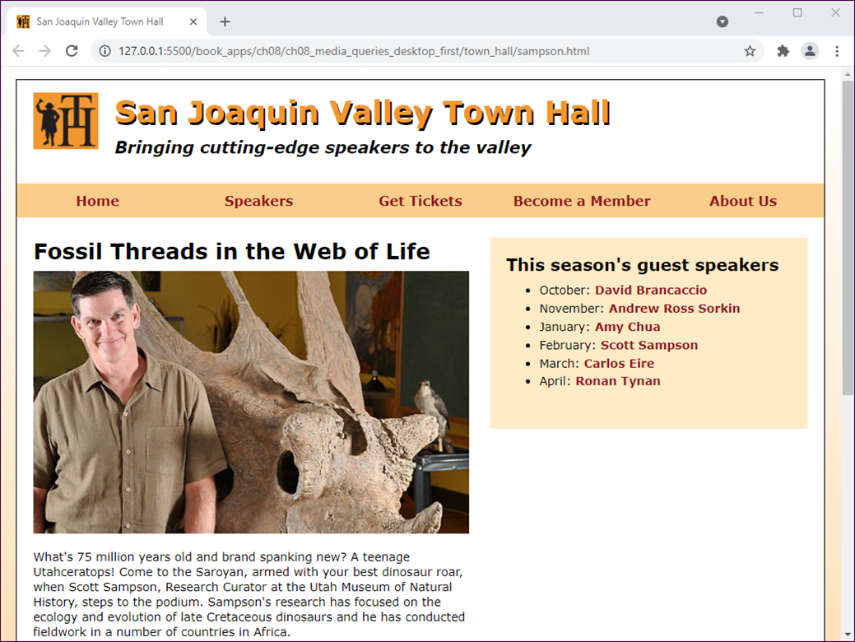
A speaker page in desktop layout

Slide 38

A speaker page in mobile layout

Slide 39
HTML for the main structural elements
<header>...</header>
<nav id="mobile_menu"></nav>
<nav id="nav_menu">
<ul>
<li><a href="index.html">Home</a></li>
...
</ul>
</nav>
<main>
<article>
<h1>Fossil Threads in the Web of Life</h1>
<img src="images/sampson.jpg" alt="Scott Sampson">
<p>What's 75 million years old and brand ... </p>
</article>
<aside>
<h2>This season's guest speakers</h2>
<nav>...</nav>
</aside>
</main>
<footer>
<p>&copy; Copyright 2022 San Joaquin Valley Town Hall.</p>
</footer>

Slide 40
The CSS for the desktop-first coding (part 1)
/* hide the mobile menu initially */
#mobile_menu { display: none; }
/* 887 pixels to 1006 pixels */
@media only screen and (max-width: 1006px) {
article h1 { font-size: 1.5em; }
aside h2 { font-size: 1.125em; } }
/* 797 pixels to 886 pixels */
@media only screen and (max-width: 886px) {
#nav_menu ul li a { font-size: .875em; }
article h1 { font-size: 1.25em; }
aside h2 { font-size: 1em; } /* base font size */
aside li { font-size: .8125em; } }

Slide 41
The CSS for the desktop-first coding (part 2)
/* 481 pixels to 796 pixels */
@media only screen and (max-width: 796px) {
#nav_menu { display: none; }
#mobile_menu {
display: block; } /* display mobile menu */
.slicknav_menu {
background-color: #facd8a !important; }
body { width: 100%; /* full width of screen */
margin: 0; /* no margins */
border: none; } /* no border */
header img { float: none; }
header, footer p { text-align: center; }
header h2 { font-size: 1.625em;
margin: .4em 0 .25em 0; }
header h3 { font-size: 1em; /* base font size */
margin-left: 0; }
footer p { margin-right: 0; }

Slide 42
The CSS for the desktop-first coding (part 3)
article { width: 95.9596%;
float: none;
margin-right: 2.0202%;
padding-right: 0; }
article img { float: left;
width: 50%;
margin-right: 2%; }
article p { font-size: .8125em; }
aside { width: 91.9192%;
float: none;
margin: 0 2.0202% 2.0202% 2.0202%; } }

Slide 43
The CSS for the desktop-first coding (part 4)
/* 383 pixels to 480 pixels */
@media only screen and (max-width: 480px) {
header h2 { font-size: 1.375em; }
header h3 { font-size: .875em; }
article h1 { font-size: 1.125em; } }
/* 382 pixels or less */
@media only screen and (max-width: 382px) {
header h2 { font-size: 1.125em; }
header h3 { font-size: .75em; }
article img { float: none;
width: 100%;
margin-right: 0; }
article h1 { font-size: 1em; } /* base font size */
footer p { font-size: .6875em; } }

Slide 44
The CSS for mobile-first coding (part 1)
/* styles for the type selectors */
body {
font-family: Verdana, Arial, Helvetica, sans-serif;
font-size: 100%;
width: 100%;
margin: 0;
padding: 15px 0; }
article, aside, h1, h2, h3, p {
margin: 0;
padding: 0; }
article, aside { margin-bottom: 1em; }
p {
font-size: .8125em;
padding-bottom: .5em;
line-height: 130%; }
em { font-weight: bold; }
a {
font-weight: bold;
text-decoration: none; }
a:link, a:visited { color: #931420; }
a:hover, a:focus { color: black; }

Slide 45
The CSS for mobile-first coding (part 2)
/* the styles for the header */
header {
width: 100%;
padding-bottom: 2em;
text-align: center; }
header img {
width: 8.0808%;
max-width: 80px;
min-width: 40px; }
header h2 {
font-size: 1.125em;
color: #f2972e;
text-shadow: 2px 3px 0 black;
margin-bottom: .25em; }
header h3 {
font-size: .75em;
font-style: italic;
margin-left: 0; }
#mobile_menu { display: block; }
.slicknav_menu { background-color: #facd8a !important; }
#nav_menu { display: none; } /* hide the nav menu */

Slide 46
The CSS for mobile-first coding (part 3)
/* 383 pixels to 480 pixels */
@media only screen and (min-width: 383px) {
header h2 { font-size: 1.375em; }
header h3 { font-size: .875em; }
article img { float: left;
max-width: 50%;
margin-right: 2%; }
article h1 { font-size: 1.125em; }
footer p { font-size: .75em; } }
/* 481 pixels to 796 pixels */
@media only screen and (min-width: 481px) {
header h2 { font-size: 1.625em; }
header h3 { font-size: 1em; } }

Slide 47
The CSS for mobile-first coding (part 4)
/* 797 pixels to 886 pixels */
@media only screen and (min-width: 797px) {
html { background-image: linear-gradient(
to bottom, white 0%, #facd8a 100%); }
body { width: 96%;
background-color: white;
margin: 15px auto;
border: 1px solid black; }
header { text-align: left; }
header img { float: left; margin-left: 2.0202% }
header h2 { font-size: 2.25em;
margin-left: 12.12121%; }
header h3 { font-size: 1.25em;
margin-left: 12.12121%; }
#nav_menu { display: block; }
#mobile_menu { display: none; }
/* same styles as desktop-first at 797px and above */

Slide 48
The CSS for mobile-first coding (part 5)
article { width: 54.0404%;
float: left;
margin-left: 2.0202%;
padding: 1.5em 0 0 0; }
article h1 { font-size: 1.25em; }
article img { max-width: 100%;
margin-right: 0;
float: none; }
aside { width: 35.35353%;
float: left;
margin: 1.5em 2.0202% 0 0; }
footer { clear: both;
text-align: right;
margin-right: 2.0202%; } }

Slide 49
The CSS for mobile-first coding (part 6)
/* 887 pixels to 1006 pixels */
@media only screen and (min-width: 887px) {
/* further enlarge fonts
in nav menu, article, and aside */
}
/* 1007 pixels or more */
@media only screen and (min-width: 1007px) {
body { max-width: 1200px; }
/* further enlarge fonts
in nav, article, and aside */
}

Slide 50
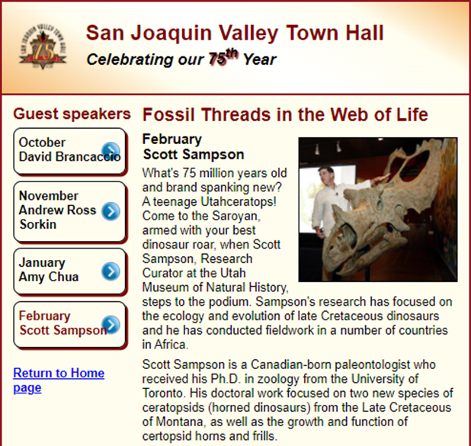
Short 8-1 Create a fluid design

Slide 51
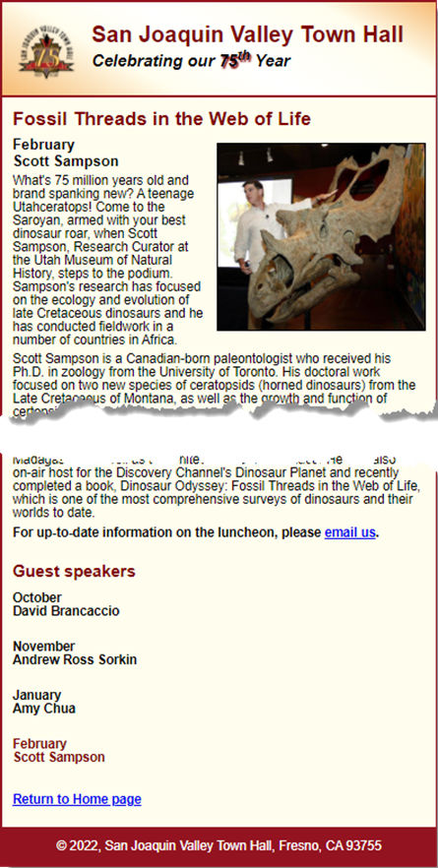
Short 8-2 Add two media queries

